Slide 1
Tourism Marketing for small businesses
Chapter 4
Tourism Marketing Planning

Slide 2
Chapter learning aims
To enhance your understanding of:
marketing planning as a forward thinking process
the importance of marketing planning in striving to gain a competitive edge
the key stages in marketing planning

Slide 3
Key terms
Competitive edge
While competitive advantage is a common term, a competitive edge is a more realistic ambition for small tourism businesses. A competitive edge is gained when the business uses a strength to take advantage of an opportunity before rivals do.
Strength
A resource controlled by the firm, which is valuable in terms of either increasing revenue or decreasing costs, and is relatively rare among competitors in a target market.
Opportunity
A positive force in the external macro-environment, over which the firm has no control.

Slide 4
Marketing planning cycle
Situation analysis
Performance measurement
Development of tactics
Development of objectives

Slide 5
Marketing planning stages
Stage | Informal question | Formal term
1 | Where are we now? | Situation analysis
2 | Where do we want to go? | Development of objectives
3 | How do we get there? | Tactics implementation
4 | How will we know we got there? | Performance monitoring

Slide 6
Operating in a ‘dynamic’ (constantly changing) market
We live in an age of ‘continuous discontinuous change’
This requires constant monitoring of the environment
To identify those changes with the potential to impact on our business
Either positively or negatively
Opportunity Threat

Slide 7
Situation analysis: STEEPL
Also known as STEP, PEST, PLEETS
A framework for analysing opportunities and threats in the macro-environment
Socio-cultural forces
Technological forces
Economic forces
Environmental forces
Political forces
Legislative forces

Slide 8
Futurists
www.thefutureplace.com Ray Poynter
http://www.trendwatching.com/
www.wfs.org
Charles Handy
Alvin Toffler
Peter Drucker
John Naisbett
Faith Popcorn

Slide 9
Situation analysis: SW/OT
Strengths – internal resources/we control
Weaknesses – internal resources/we control
______________________________________________________________________________________________________________
Opportunities – external forces/we don’t control
Threats – external forces/we don’t control

Slide 10
What are ‘strengths’?
KEYPOINT = relative to competitors
Resources controlled by the firm
Importance of resource audit
Market specific
Eg might differ between Japan market and USA market
Situation specific
Eg Short break needs versus family summer holiday needs

Slide 11
Sustainable competitive advantage
How do we know when we have got it?
3 conditions must exist:
1. Customer perceives a difference over rivals
2. Difference is a capability gap – Rivals cant match
3. Gap must endure over time

Slide 12
Differentiation
Crowded tourism markets where consumers are spoilt by choice of ‘me too’ products
Parity = substitutability
What do consumers value?
What do you value as a consumer?
Cheaper
Faster
Better

Slide 13
Jay Barney
Asked hundreds of successful businesses what it is they do that has given them a competitive advantage
The most common reply:
“Worked hard, took risks, and surrounded ourselves with the best people”
However, this is not a source of advantage
All businesses would share the same strengths
Proposition = ‘strengths’ are heterogeneous and immobile across firms

Slide 14
Barney’s VRIO resource model
Resources should be:
Valuable – what makes a resource of value to an organisation?
Reducing costs, or
Increasing income
Rare
Relative to competitors
difficult to Imitate by competitors
and…
The firm must be Organised in a way that capitalises on the resource

Slide 15
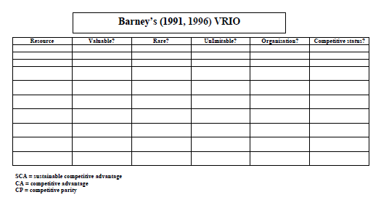
VRIO

Slide 16
VRIO
CP = competitive parity (therefore not a ‘strength’)
CA = competitive advantage via a value strategy not implemented by rivals (may only be temporary)
SCA = sustained CA is unduplicable (but doesn't necessarily mean forever)

Slide 17
Opportunities for obtaining a ‘strength’
1. Access to a unique resource
2. Innovative use of technology
3. Unique patented attraction or activity
4. Unique access to suppliers/customers via vertical integration
Recognised brand
Location, location, location
Unique history
Access to capital
Famous host

Slide 18
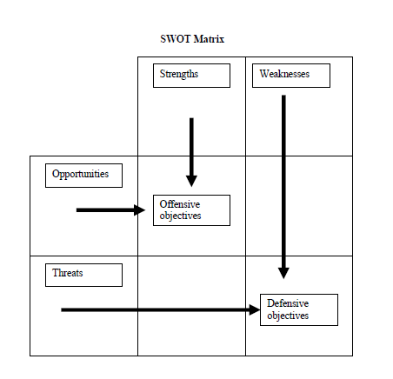
SW/OT matrix to develop objectives

Slide 19
SW/OT matrix
The SWOT as a platform to develop strategy options
Ideal for brainstorming
Ideal for justifying promotional tactics
How can we use our strengths to maximise opportunities?
What can we do about our weaknesses to minimise the threats?

Slide 20
Remember…
An opportunity is a positive macro-environment force over which the business has no control
An opportunity is not “To advertise on bus shelters” as this is a tactic
A strength is relative to competitors…if other businesses have the same resource then it is not a strength
A small business will only have one or two strengths at best
Strengths are difficult to obtain in markets crowded with competitors offering similar services and benefits

Slide 21
Discussion questions
Why will a small tourism business only realistically have one or a few strengths?
Why are the following not representative of an opportunity in the SW/OT Matrix?
To create a virtual reality experience.
To advertise on nearby bus shelters
To develop a Facebook page
Why is a situation analysis so important in the marketing planning process?

